Slide 1


258 - Deep Learning
LARGE LANGUAGE MODELS FOR EDUCATION: A SURVEY AND OUTLOOK
BY: MANSI VEKARIYA

Slide 2
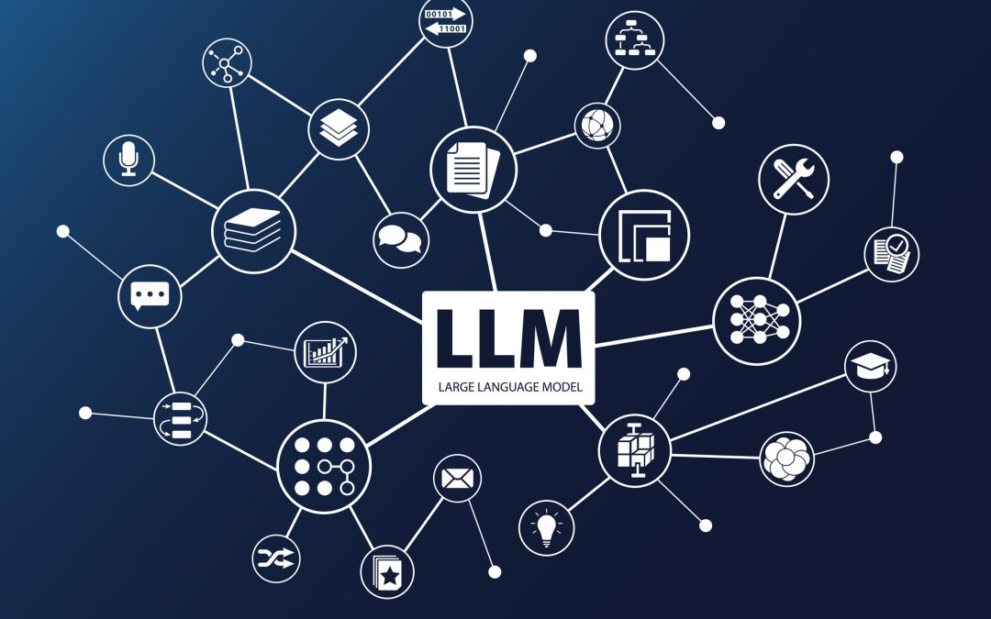

INTRODUCTION
In the age of artificial intelligence, Large Language Models (LLMs) like GPT-3 and BERT have not only captured the imagination of tech enthusiasts but have also begun to significantly alter the landscape of various industries. Education, a field as ancient as civilization itself, is no exception to this technological revolution. A recent comprehensive survey sheds light on how these sophisticated AI models are making inroads into educational settings, promising to transform how students learn and teachers teach. This article delves into the findings of this survey, exploring the vast potential of LLMs to enhance educational practices and the critical considerations for their responsible implementation.
120+

Slide 3
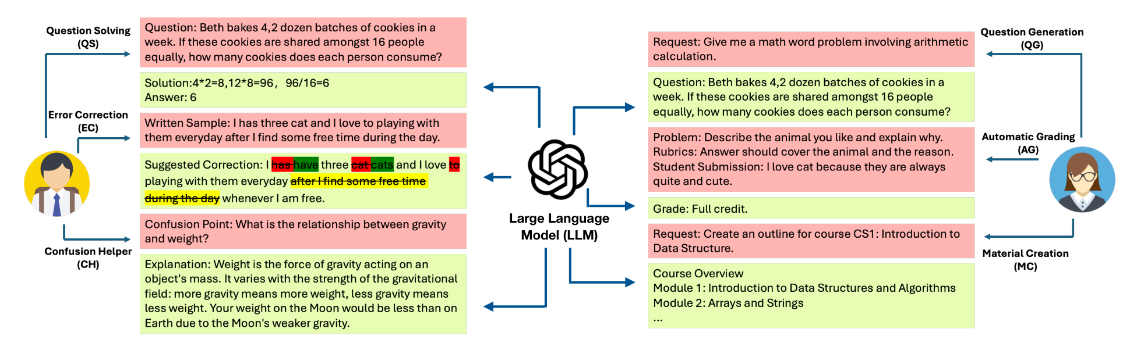
THE ROLE OF LLMS IN EDUCATION:

Slide 4
LLMs are reshaping educational paradigms through a variety of roles:
Student Assistance: LLMs offer real-time, personalized tutoring, providing explanations, solving complex problems across subjects like mathematics, science, and languages, and offering feedback on written assignments. Their ability to process and generate natural language responses allows them to act as personal tutors to students, accessible anytime and anywhere.
01
Teacher Assistance: Educators are leveraging LLMs to automate the creation of educational content, including generating quiz questions and preparing instructional materials. These tools help teachers reduce their workload, allowing them more time to focus on interactive and personalized teaching.
02
Adaptive Learning Systems: By analyzing data on students' learning patterns and progress, LLMs facilitate the creation of adaptive learning platforms that tailor educational content to the needs of individual students, enhancing learning outcomes and engagement.
03

Slide 5
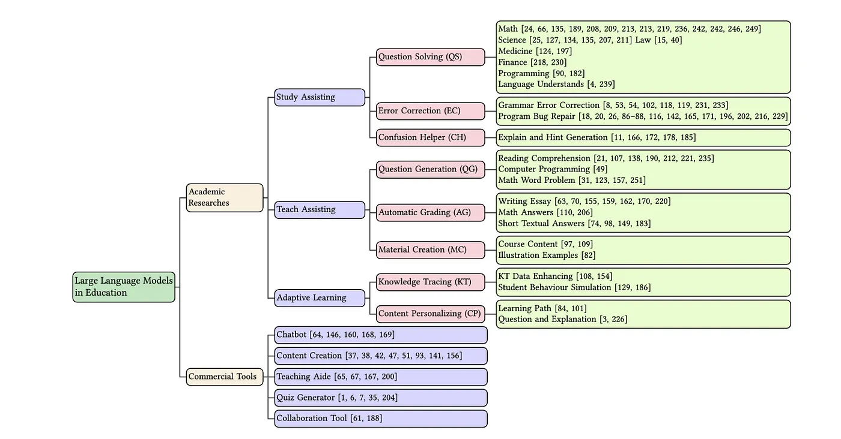

Slide 6

ARCHITECTURAL INSIGHTS:
LLMs utilized in educational settings typically follow a robust architecture involving extensive pre-training on diverse datasets, ranging from textbooks to online forums. This training equips them with a broad understanding of language and knowledge across multiple domains. Fine-tuning these models on specific educational tasks allows for more tailored responses, aligning with curriculum requirements and pedagogical goals.

Slide 7
Key Metrics and Ablation Studies:
THE EFFECTIVENESS OF LLMS IN EDUCATION IS MEASURED THROUGH VARIOUS METRICS:
ACCURACY: HOW CORRECTLY LLMS ANSWER EDUCATIONAL QUESTIONS OR SOLVE PROBLEMS.
ENGAGEMENT: THE EXTENT TO WHICH LLMS CAN MAINTAIN STUDENTS' INTEREST AND INTERACTION.
PERSONALIZATION EFFECTIVENESS: HOW WELL THE MODEL ADAPTS TO INDIVIDUAL LEARNING STYLES AND SPEEDS. ABLATION STUDIES WITHIN THIS FIELD OFTEN FOCUS ON DISSECTING WHICH COMPONENTS OF AN LLM'S TRAINING CONTRIBUTE MOST SIGNIFICANTLY TO ITS EFFECTIVENESS, HELPING RESEARCHERS REFINE AND OPTIMIZE EDUCATIONAL AI TOOLS.

Slide 8
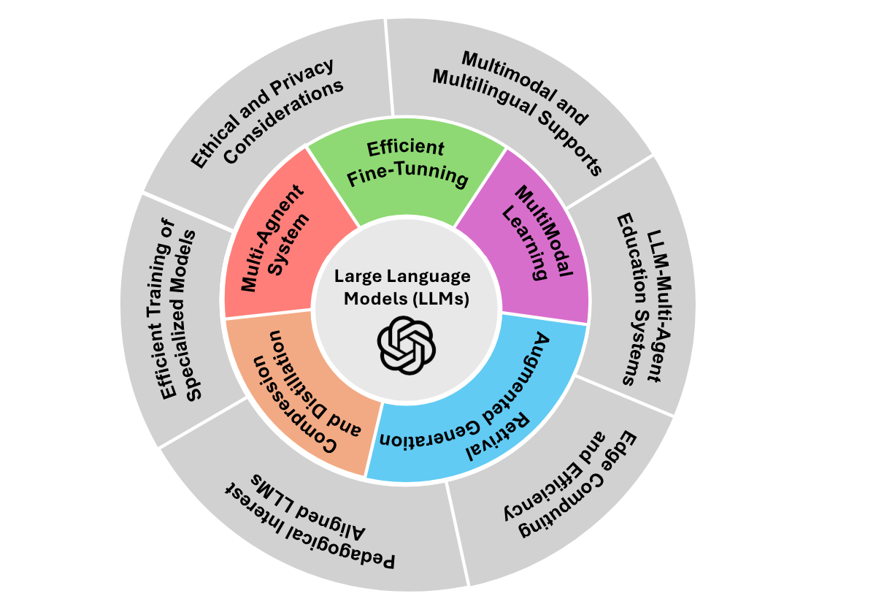
CHALLENGES AND FUTURE PROSPECTS:
Despite their potential, integrating LLMs into educational settings is not without challenges:
Bias and Fairness: LLMs can inadvertently perpetuate biases present in their training data, leading to fairness issues in educational contexts.
Privacy Concerns: Handling sensitive student data requires robust privacy protections to prevent misuse and ensure compliance with educational standards.
Dependence and De-skilling: There's a risk that over-reliance on AI tools might lead to a decline in critical thinking and problem-solving skills among students.

Slide 9
CONCLUSION:
Large Language Models hold incredible promise to revolutionize educational practices, offering personalized, engaging, and efficient learning experiences. However, as we navigate this promising future, it is imperative to balance innovation with careful consideration of ethical implications and potential risks. By fostering an ongoing dialogue among educators, technologists, and policymakers, we can harness the power of LLMs to enhance educational outcomes while ensuring they serve the diverse needs of all students.

Slide 10
THANK YOU

